Slide 1
Illumination (Lighting)
CSU0021: Computer Graphics

Slide 2
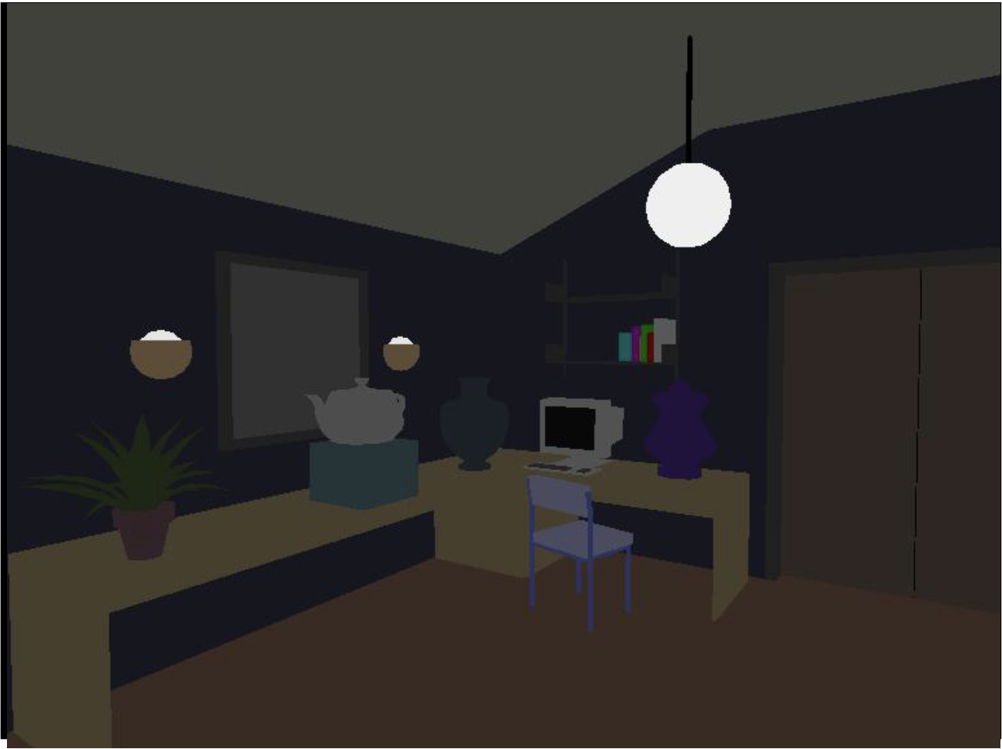
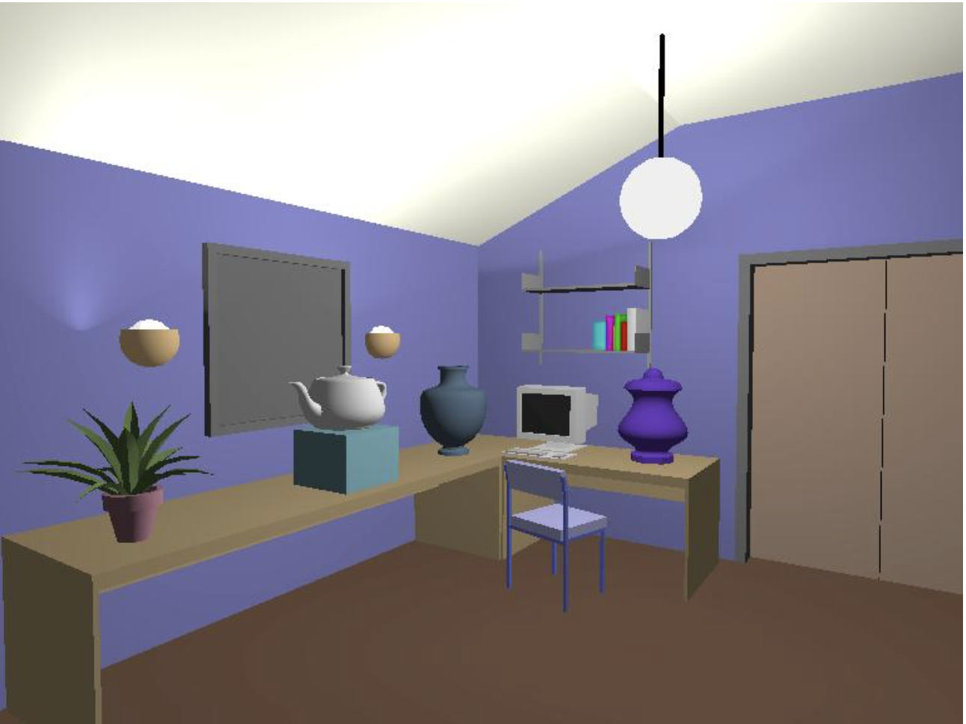
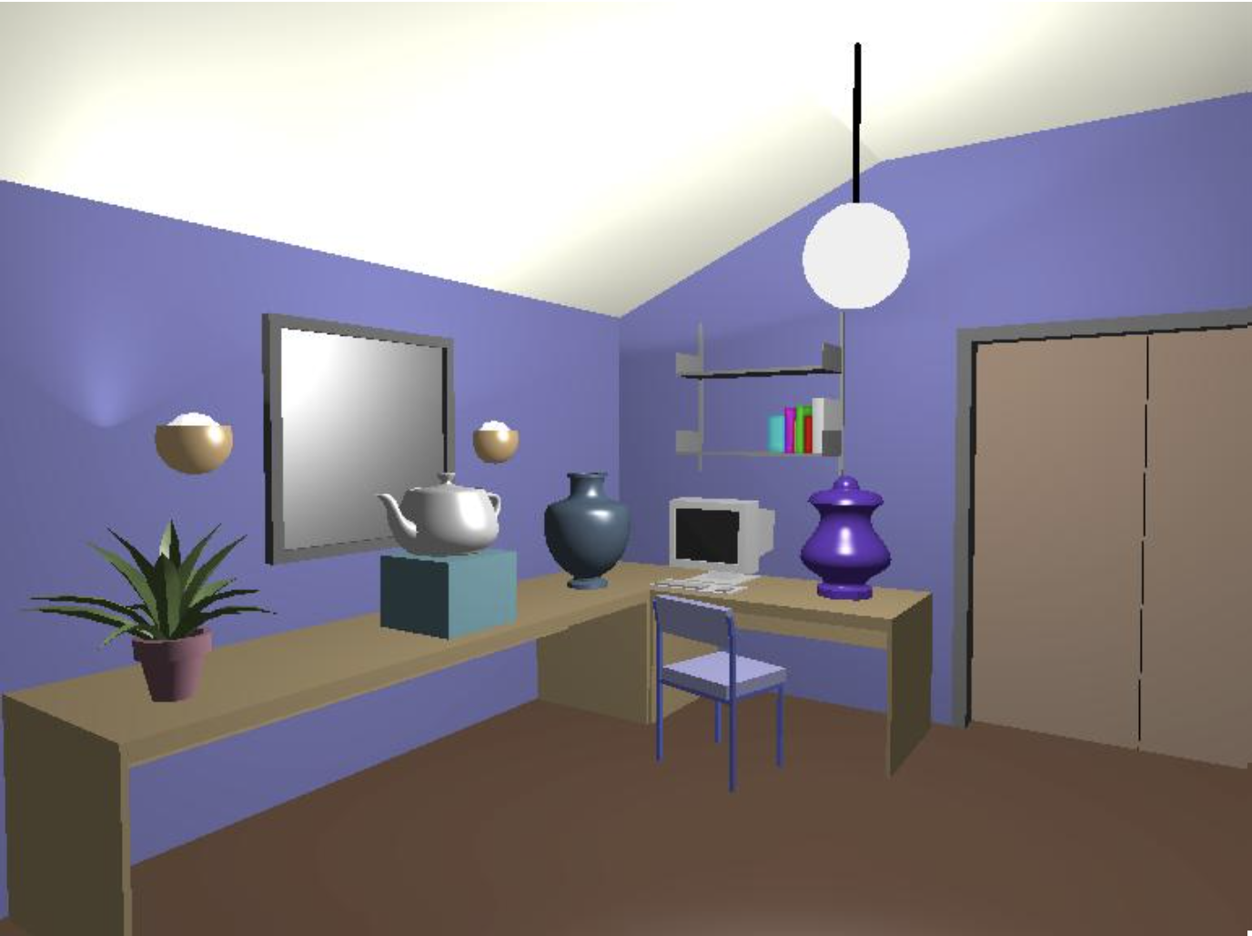
Illumination

Slide 3
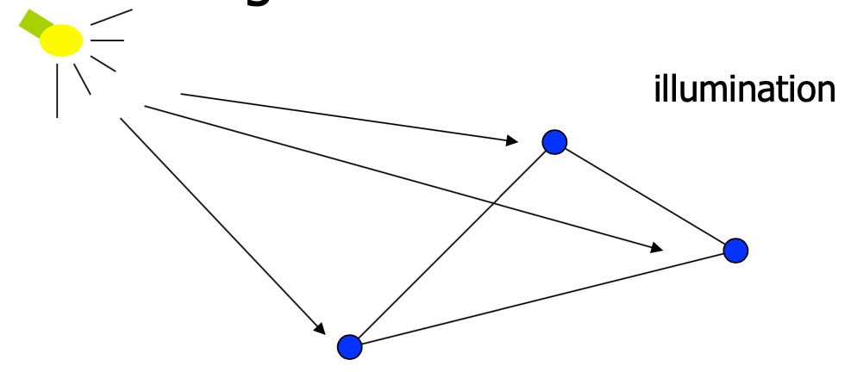
Illumination
Model the interaction of light with surface points to determine their final color and brightness
The illumination can be computed either at vertices or fragments

Slide 4
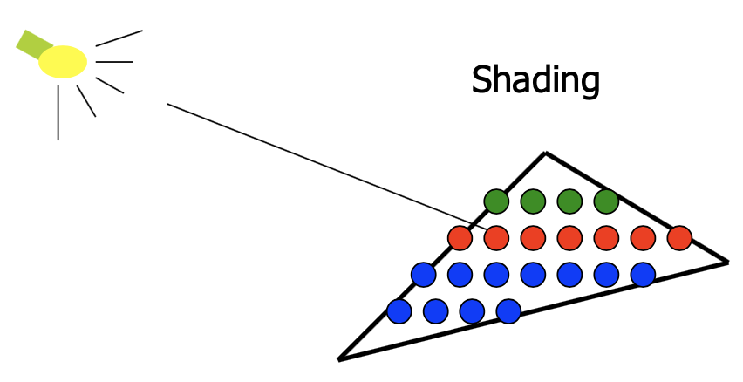
Shading
Interpolation from the vertex illumination
Or apply the lighting model at a set of points across entire surface

Slide 5
Illumination Model
The governing principles for computing the illumination
A illumination model usually considers:
Light attributes: light intensity, color, position, direction, shape
Object surface attributes: color, reflectivity, transparency, etc.
Interaction among lights and objects: object orientation
Interaction between objects and eye: viewing direction

Slide 6
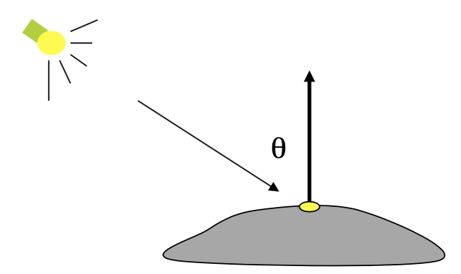
Illumination Calculation
Local illumination: only consider the light, the observer position, and the object material properties

Slide 7
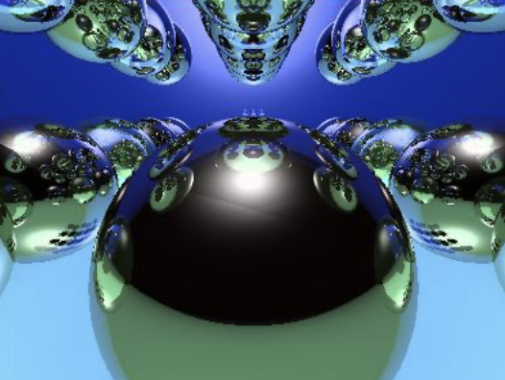
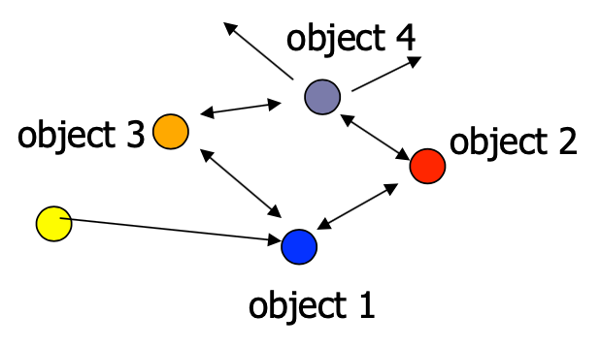
Illumination Models
Global illumination: take into account the interaction of light from all the surfaces in the scene
Ray Tracing (advanced computer graphics)

Slide 8
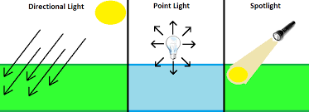
Basic Light Sources
Point light
Emit light to all directions
E.g. light bulb, fire. Defined by the light position and light color
Directional light
E.g. sum. Just defined by a direction and light color
Spot light
Light intensity can be independent or dependent
of the distance between objects and the light source

Slide 9
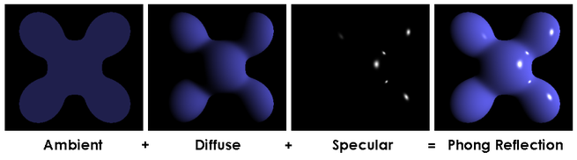
Simple Local Illumination
Local illumination: https://en.wikipedia.org/wiki/Phong_shading#:~:text=In%203D%20computer%20graphics%2C%20Phong,or%20normal%2Dvector%20interpolation%20shading.
Ambient
Diffuse
Specular
Consider these three types of light contribution to compute the final illumination of an object

Slide 10
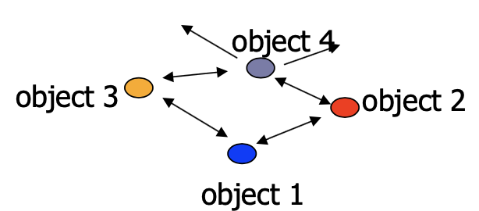
Ambient Light
Ambient light (background light): the light that is scattered by the environment
A very simple approximation of global illumination
Independent of the light position, object orientation, observer’s position or orientation – ambient light has no direction

Slide 11
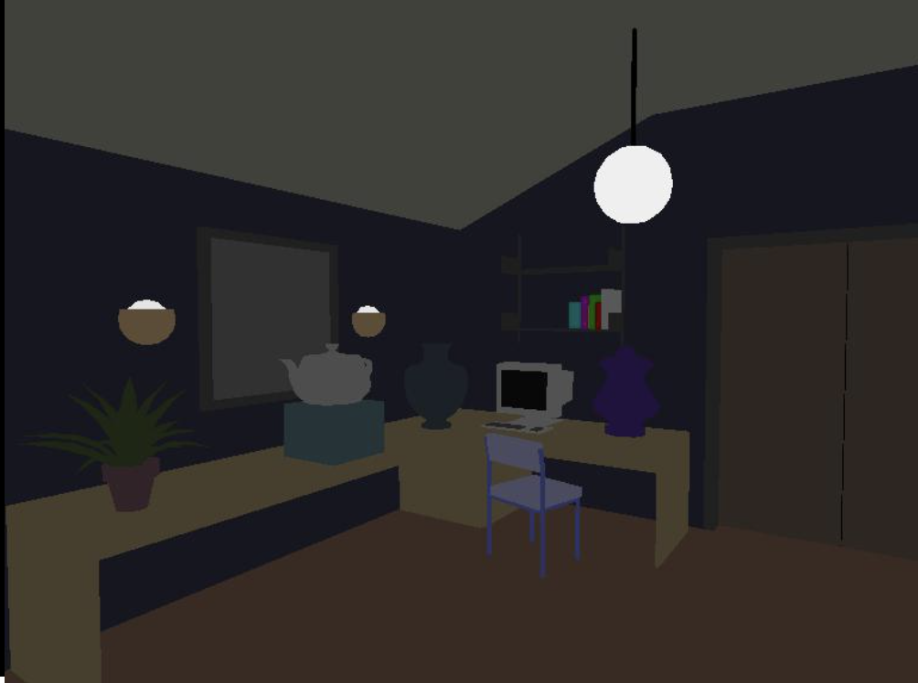
Ambient Light Example

Slide 12
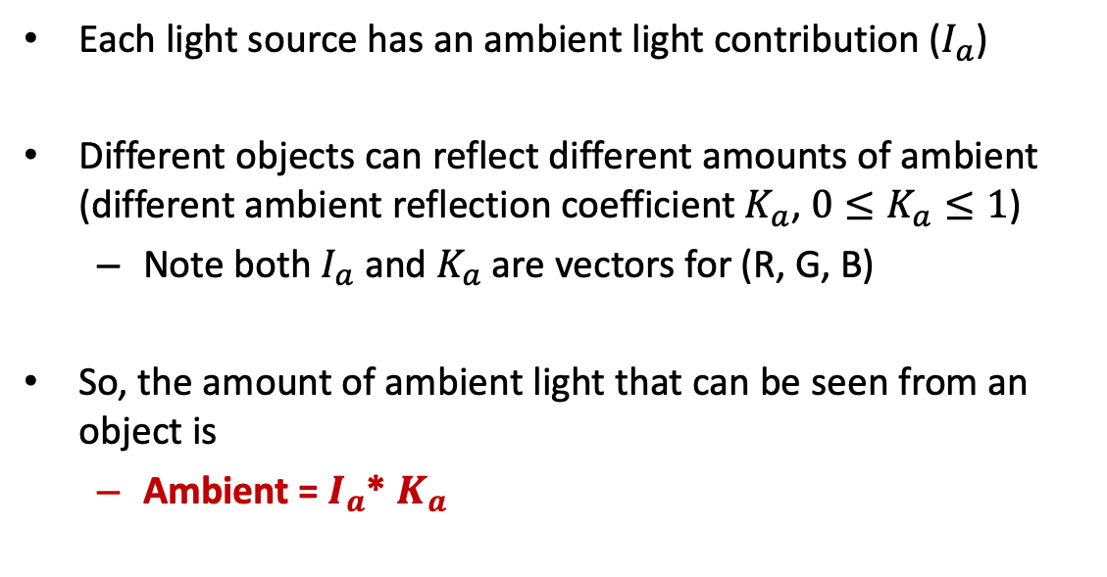
Ambient Light Calculation
Each light source has an ambient light contribution ($I_{a}$)
Different objects can reflect different amounts of ambient (different ambient reflection coefficient $K_{a}$, $0≤K_{a}≤1$)
Note both $I_{a}$ and $K_{a}$ are vectors for (R, G, B)
So, the amount of ambient light that can be seen from an object is
Ambient = $I_{a}$* $K_{a}$

Slide 13
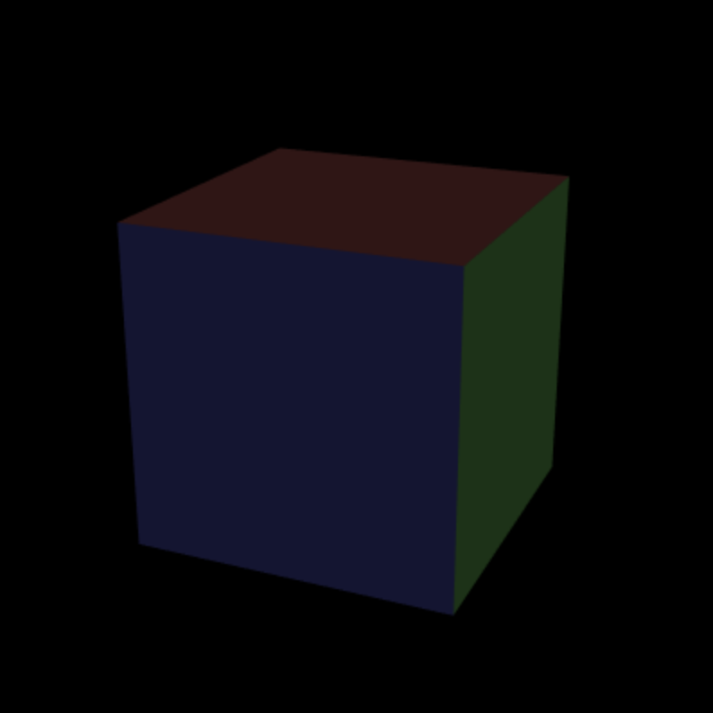
Example (Ex06-1)
Create a cube and apply ambient light on it
Files
index.html
WebGL.js
cuon-matrix.js

Slide 14
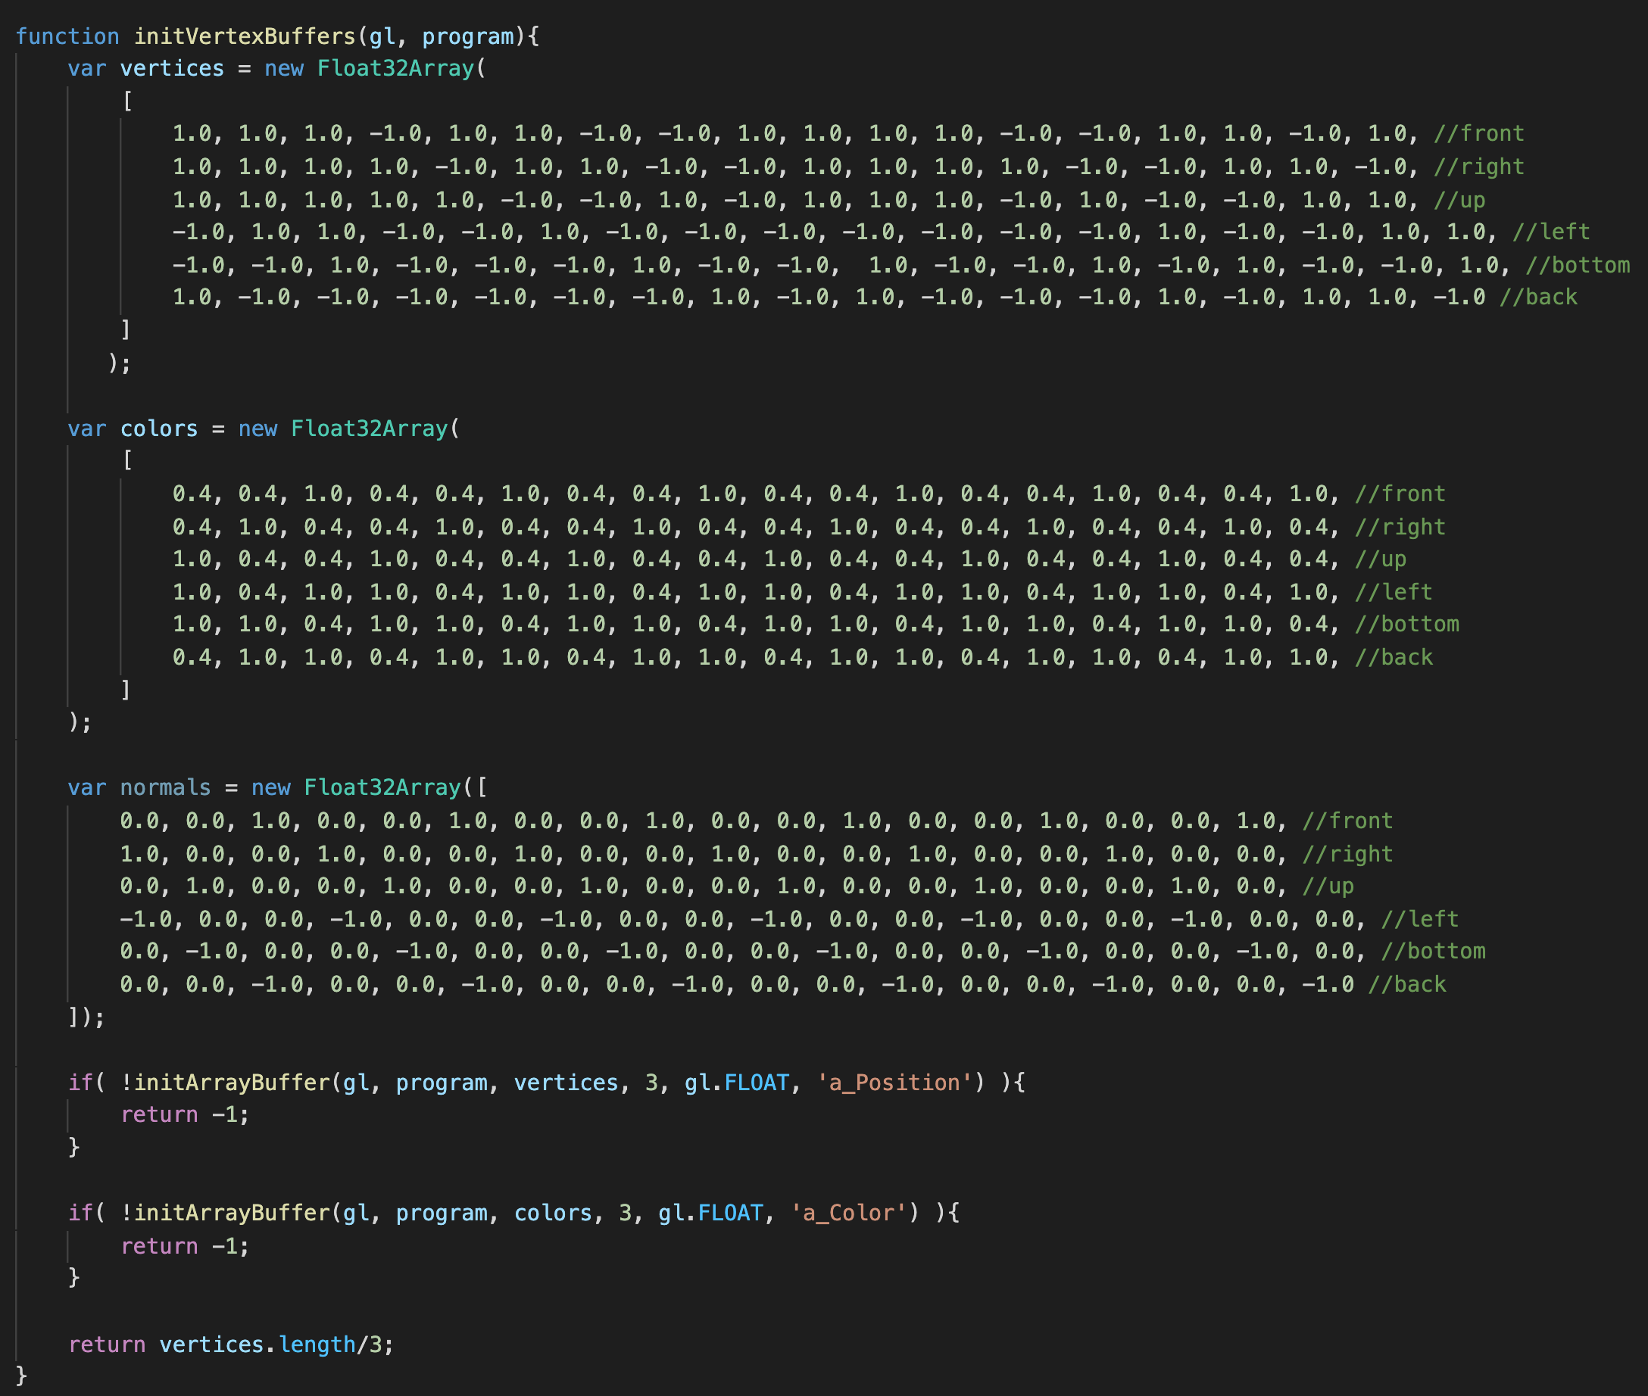
Example (Ex06-1)
initVertexBuffers in WebGL.js
Data of a cube
One cube consists of 6 faces, each face consists of 2 triangle, and each triangle has 3 vertices
Each vertex has position, color and normal vector (we do not use normal vector in this example)
Also, create vertex buffer objects in this function

Slide 15
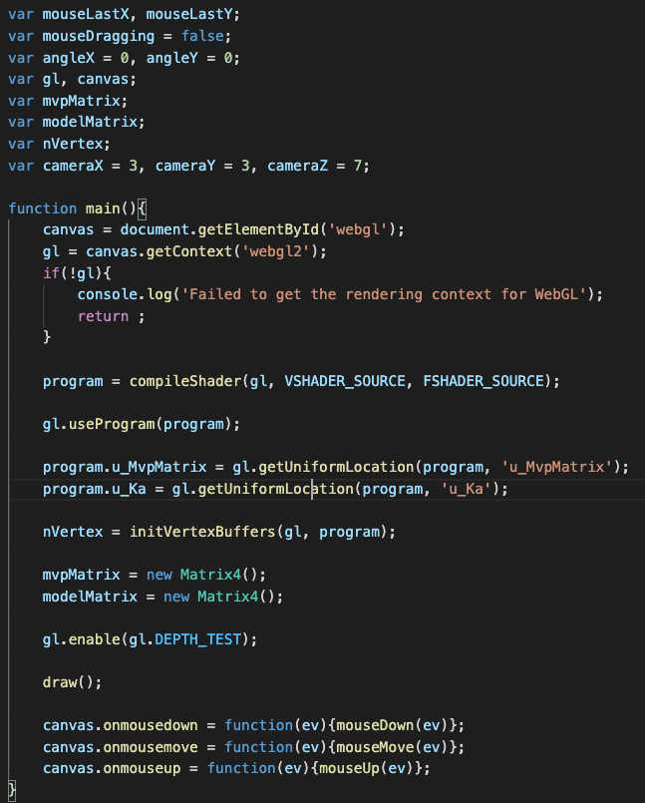
Example (Ex06-1)
For mouse control
mvpMatrix = project * view * model matrix
modelMatrix: transform point to world space
main() in WebGL.js
mvp matrix: project*view*model matrix
Ambient light factor: each face or each object
could have different ambient factor,
but I set the same value to them here
Mouse call back functions for user to rotate the objects

Slide 16
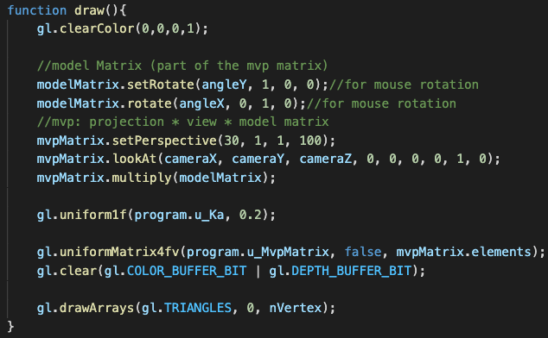
Example (Ex06-1)
draw() in WebGL.js
Pass information to shaders

Slide 17
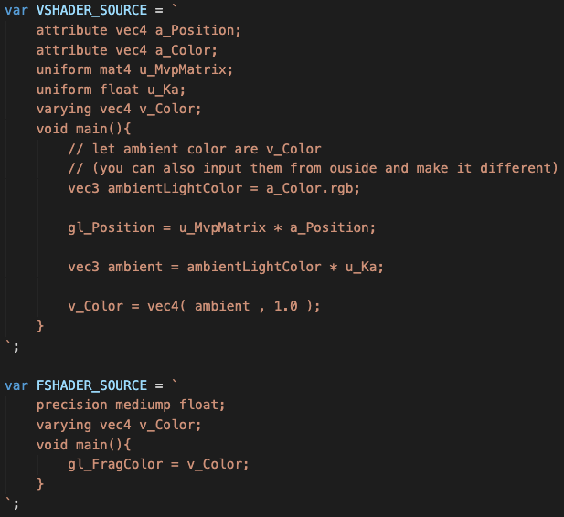
Example (Ex06-1)
Shaders in WebGL.js
Use a_Color as the ambient light color
Calculate ambient color

Slide 18
Let’s try and think (5mins)
Try to modify the ambient factor
Can the three element in ambient factor be different? If so, what happens?

Slide 19
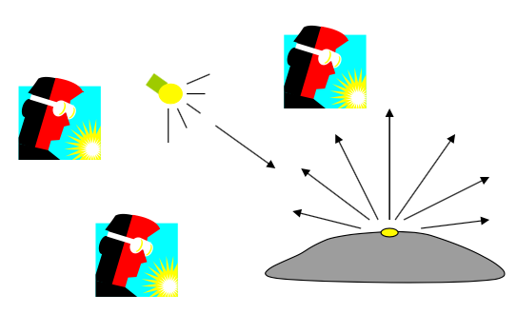
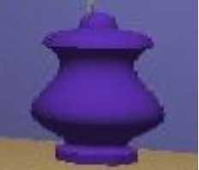
Diffuse Light
Diffuse light: The illumination that a surface receives from a light source and reflect in all direction
It does not matter where the eye is

Slide 20
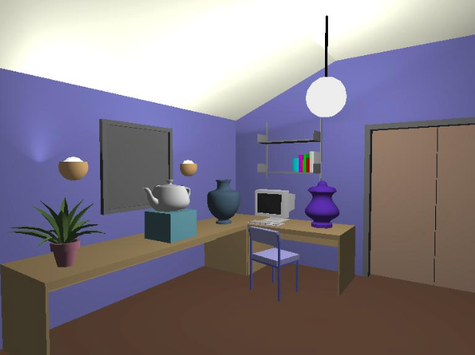
Diffuse Lighting Example

Slide 21
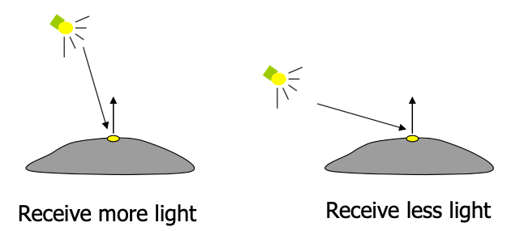
Diffuse Light Calculation
Need to decide how much light the object point receive from the light source – based on Lambert’s law

Slide 22

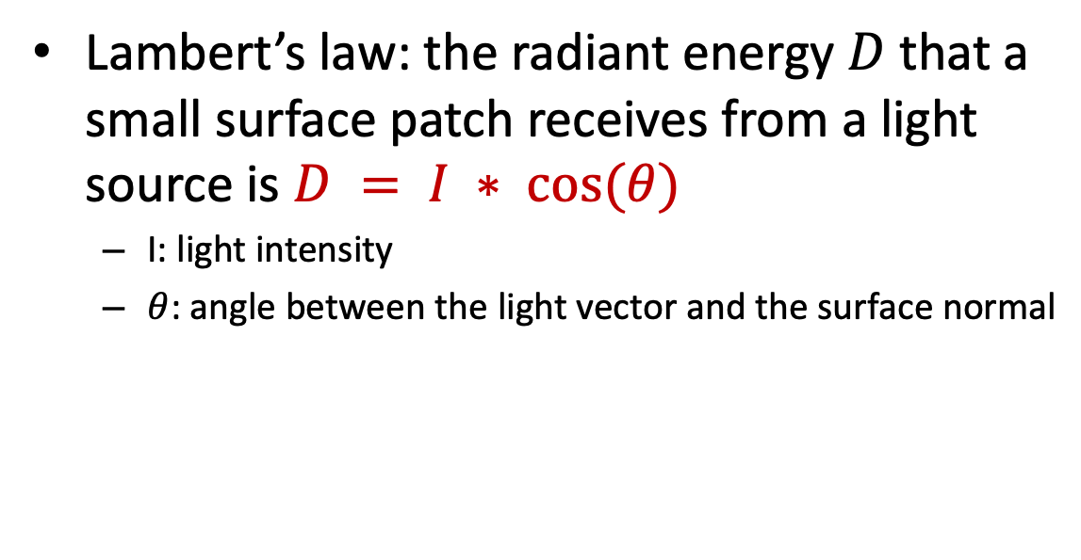
Diffuse Light Calculation
Lambert’s law: the radiant energy $D$ that a small surface patch receives from a light source is $D = I ∗ cos⁡(θ)$
I: light intensity
$θ$: angle between the light vector and the surface normal
Light vector(vector from object to light)
N: surface normal vector
$$θ$$

Slide 23
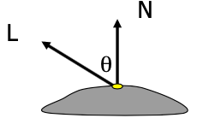
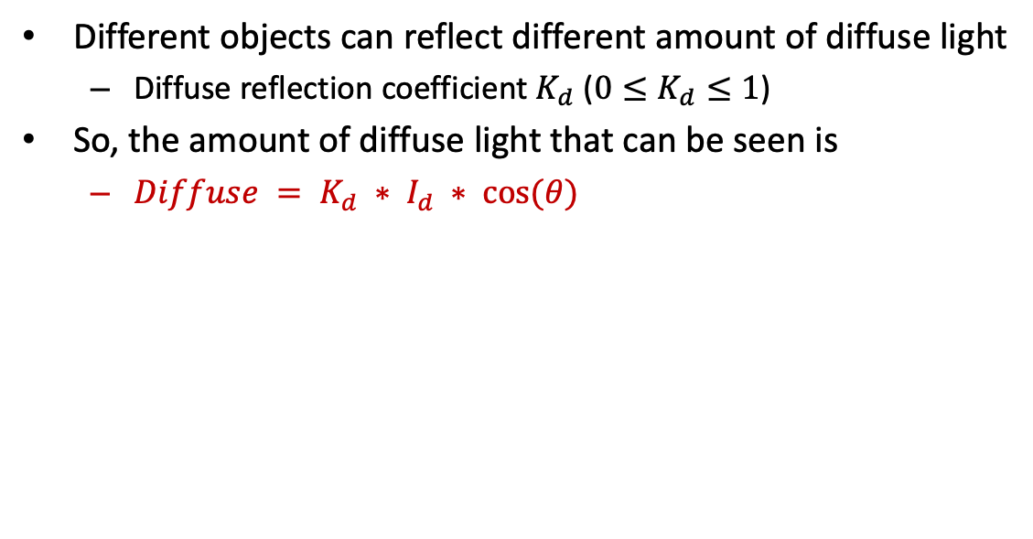
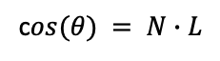
Diffuse Light Calculation
Different objects can reflect different amount of diffuse light
Diffuse reflection coefficient $K_{d}$ (${0≤K}_{d}≤1$)
So, the amount of diffuse light that can be seen is
$Diffuse = K_{d} ∗ I_{d} ∗ cos⁡(θ)$
c$os(θ) = N∙L$
I recommend to calculate “diffuse” in world space.
(this means that you can set or transform all information you need to world space, then calculate)

Slide 24

Example (Ex06-2)
Create a cube and apply ambient and diffuse light on it
Files
index.html
WebGL.js
cuon-matrix.js

Slide 25
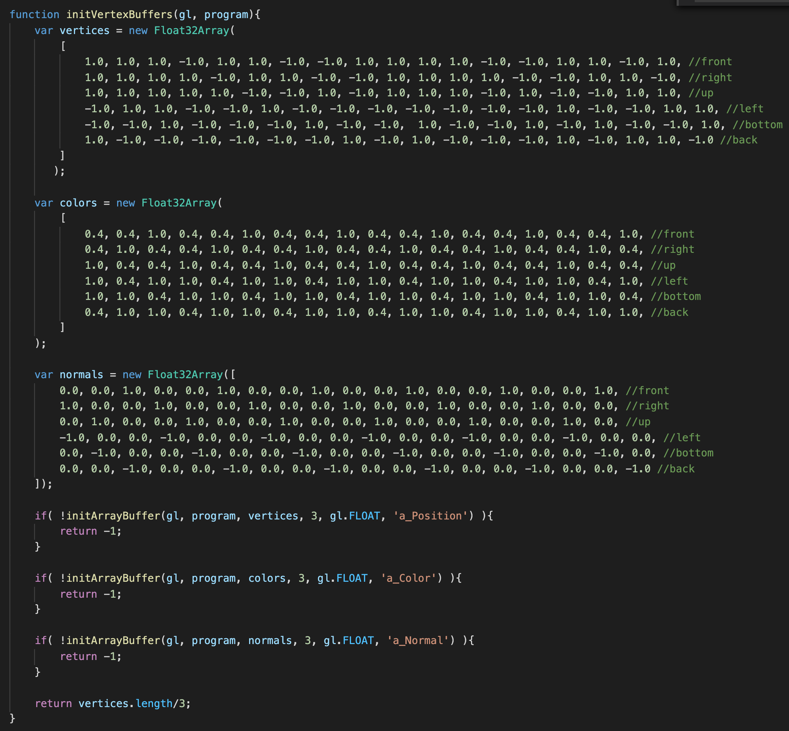
Example (Ex06-2)
initVertexBuffers in WebGL.js
Now, we need normal vector for diffusion

Slide 26
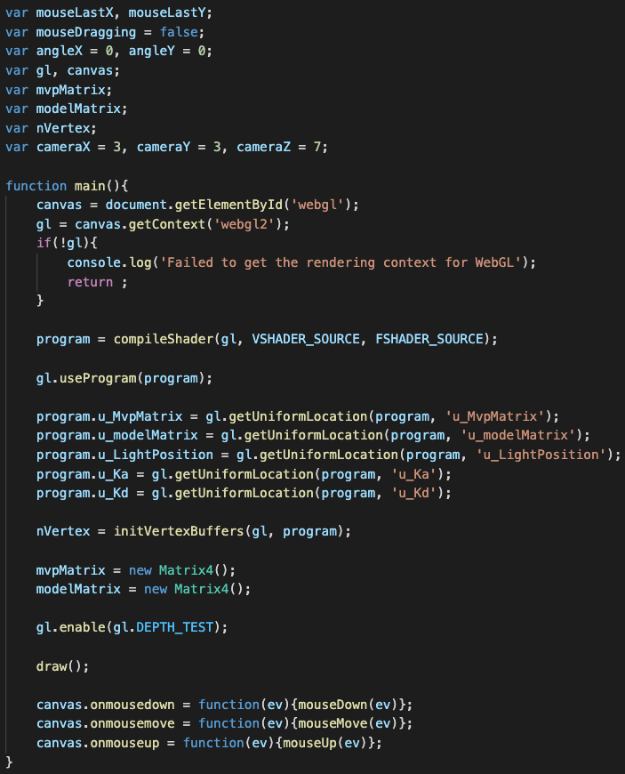
Example (Ex06-2)
main() in WebGL.js
We have to pass model matrix and light position to shader for diffusion light calculation
Purpose of the model matrix in shader: transform vertices and normal vector to world space
Diffusion factor

Slide 27
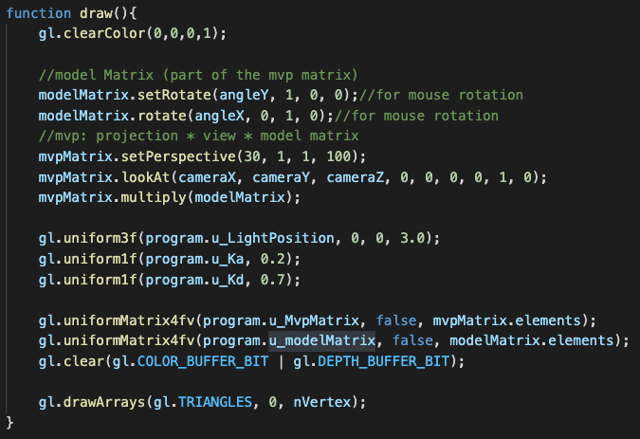
Example (Ex06-2)
draw() in WebGL.js

Slide 28
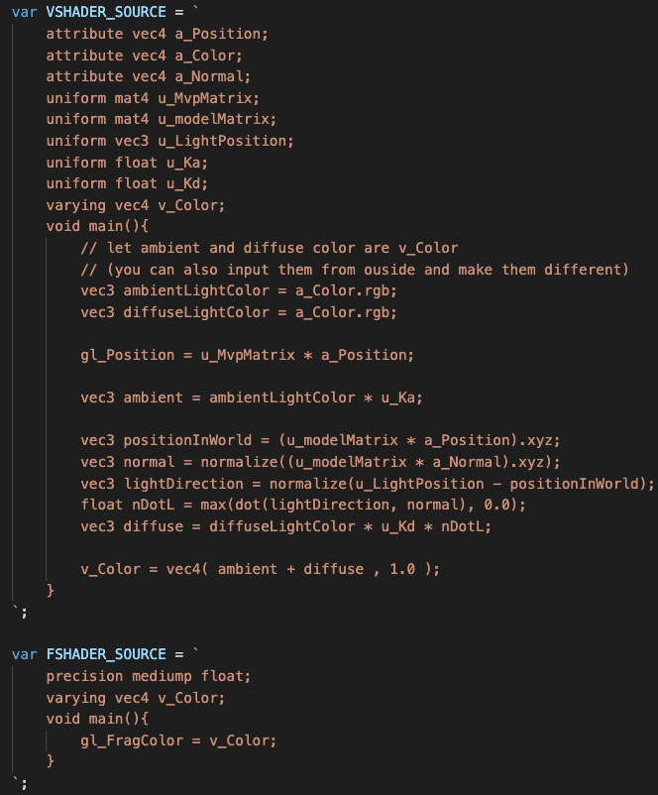
Example (Ex06-2)
Shaders in WebGL.js
Set diffuse light color to a_Color
The diffuse light calculation here is in world space.
We need model matrix to transform vertices and normal vector from object space to world space
Diffuse light calculation
Add ambient and diffuse light together

Slide 29
Let’s try and think (5mins)
Try to modify the diffusion factor
Try to modify the light position or rotate the object

Slide 30
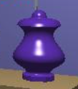
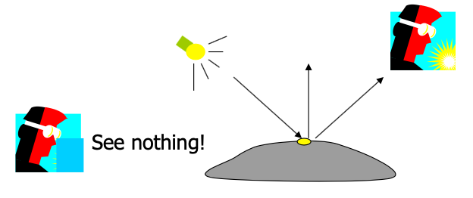
Specular Light
The bright spot on the object
The result of total reflection of the incident light in a concentrate region
Camera location matters

Slide 31
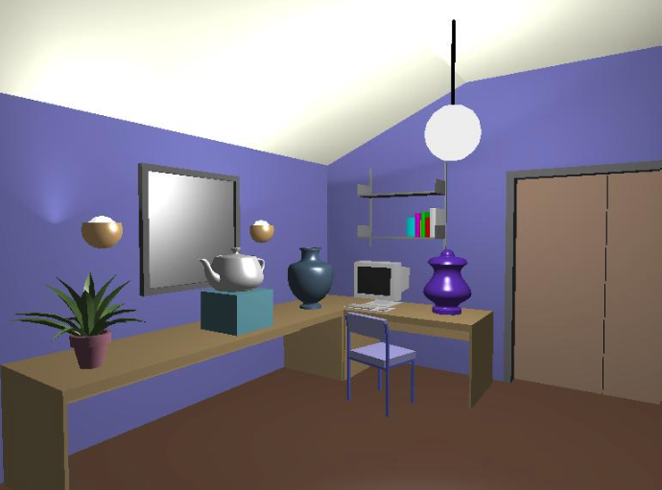
Specular Light Example

Slide 32
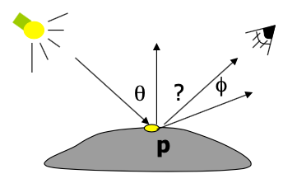
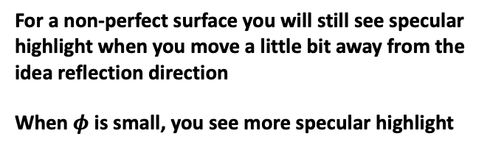
Specular Light Calculation
How much reflection you can see depends on where you are
The only position the eye can see specular from p
if the object has an ideal reflection surface
For a non-perfect surface you will still see specular
highlight when you move a little bit away from the
idea reflection direction
When $φ$ is small, you see more specular highlight

Slide 33
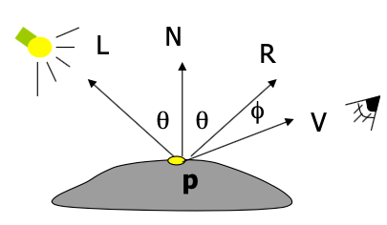
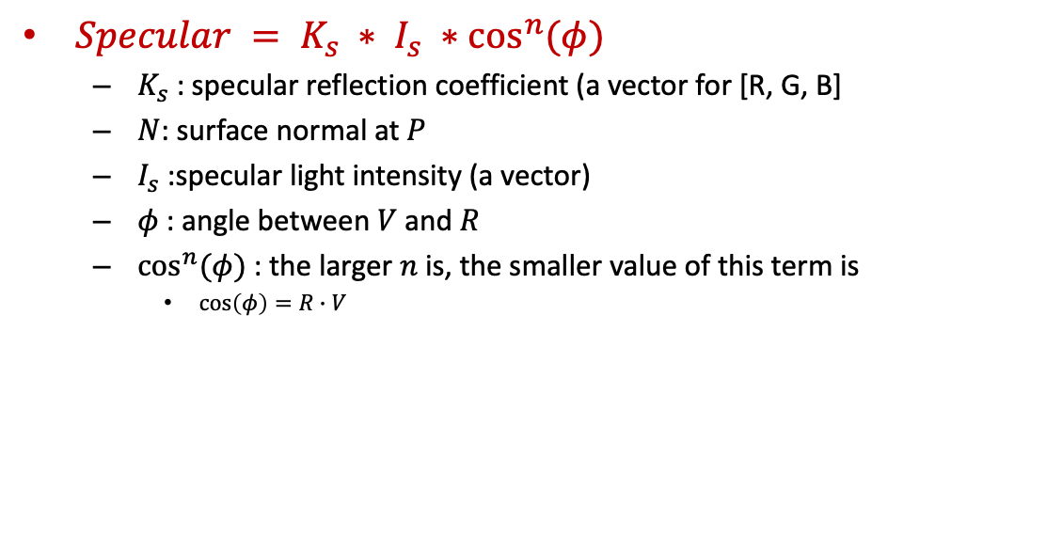
Specular Light Calculation
$Specular = K_{s} ∗ I_{s} ∗\cos^{n}{(φ)}$
$K_{s}$: specular reflection coefficient (a vector for [R, G, B]
$N$: surface normal at $P$
$I_{s}$:specular light intensity (a vector)
$φ$: angle between $V$and $R$
$\cos^{n}{(φ)}$: the larger $n$ is, the smaller value of this term is
$\cos\left(φ\right)=R∙V$
I recommend to calculate “specular” in world space.
(this means that you can set or transform all information you need to world space, then calculate)

Slide 34
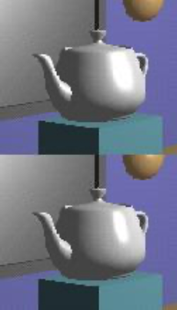
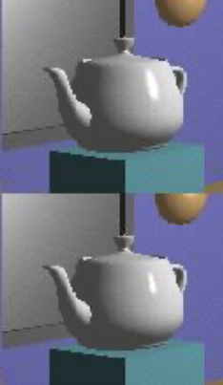
Specular Light Calculation
The effect of ‘n’ in the model
n = 10
n = 90
n = 30
n = 270

Slide 35
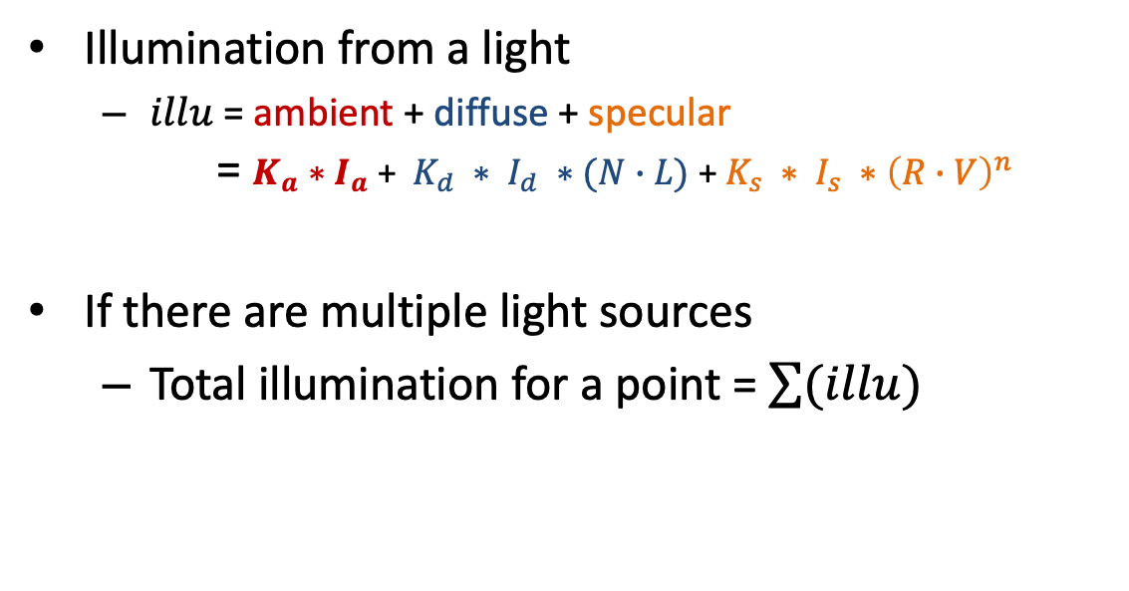
Put It All Together
Illumination from a light
$illu$ = ambient + diffuse + specular = $K_{a}∗I_{a}$ + $K_{d} ∗ I_{d} ∗(N∙L)$ + $K_{s} ∗ I_{s} ∗{\left(R∙V\right)}^{n}$
If there are multiple light sources
Total illumination for a point = $\sum{(illu)}$

Slide 36
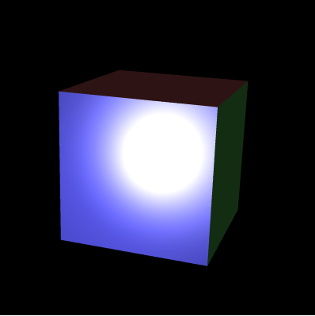
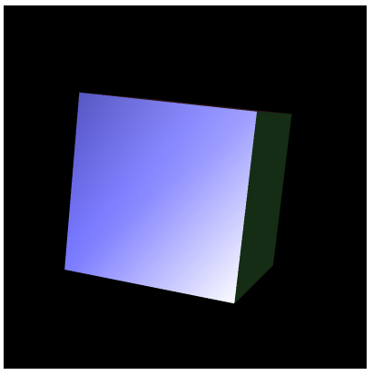
Example (Ex06-3)
Create a cube and apply ambient, diffuse and specular light color on it
This example will NOT give you the specular light you expect because we implement all illumination calculation in vertex shader
You will implement the better version in your quiz (implement it in fragment shader)
Files
index.html
WebGL.js
cuon-matrix.js

Slide 37
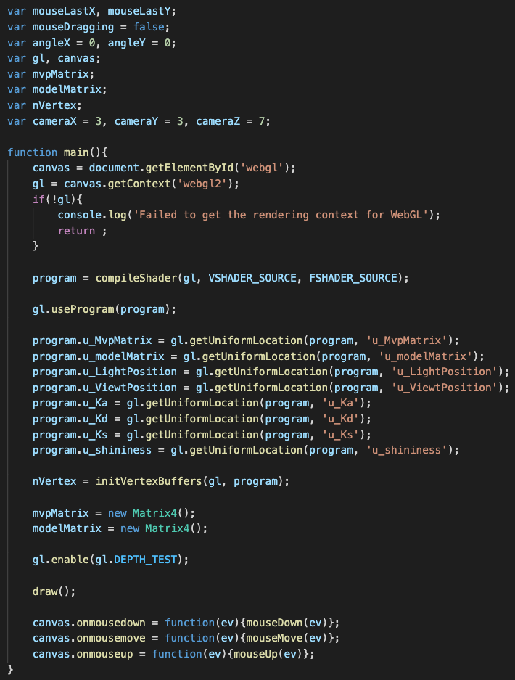
Example (Ex06-3)
main() in WebGL.js
We need view (camera) position (in world space) to calculate specular light color
specular factor

Slide 38
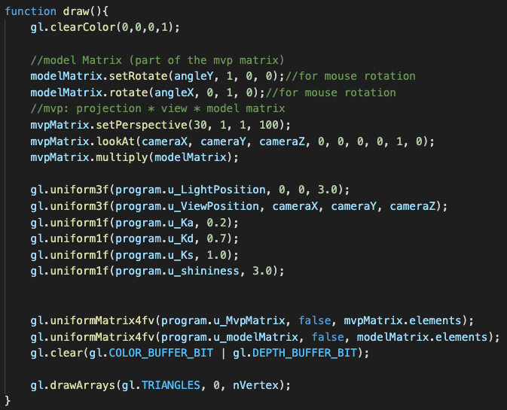
Example (Ex06-3)
draw() in WebGL.js

Slide 39
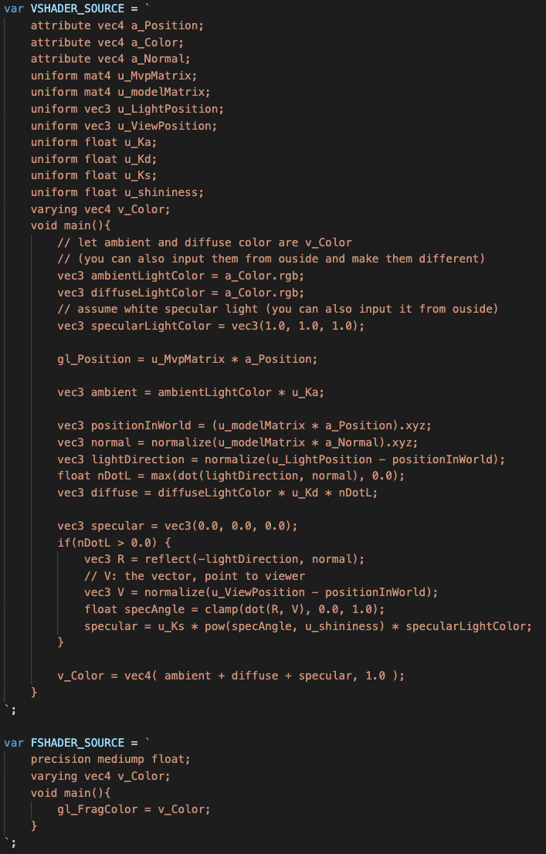
Example (Ex06-3)
Shaders in WebGL.js
We directly set white light to specular light color
The specular calculation is in world space. So, we have to transform all information we need to world space.
GLSL build-in function to calculate the reflection vector
specular light calculation
Add ambient, diffuse and specular light together

Slide 40
Let’s try and think (5mins)
A better one
Try to modify the specular factor and shininess factor
We still have two more problems
Think why this implementation does not give you a good enough specular light color
Add
modelMatrix.translate(0.0, 0.0, -1.0);
modelMatrix.scale(1.0, 0.5, 2.0);
to model matrix (add the above two line right after “modelMatrix.rotate(angleX, 0, 1, 0);” )

Slide 41
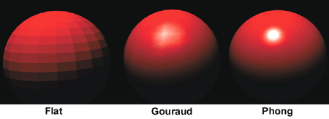
Polygon Shading Model – Flat Shading
Flat shading – compute lighting once and assign the color to the whole polygon
Only use one vertex (usually the first one) normal and material property to compute the color for the polygon
Benefit: fast
It is used when:
The polygon is small enough
The light source is far away (why?)
The eye is very far away (why?)

Slide 42
Polygon Shading Model – Flat Shading
Mach Band Effect
Flat shading suffers from “mach band effect”
Mach band effect – human eyes accentuate the discontinuity at the boundary

Slide 43
Smooth Shading
Fix the mach band effect – remove edge discontinuity
Compute lighting for more points on each face
Flat shading
Smooth shading

Slide 44
Smooth Shading
Two popular methods:
Gouraud shading
Phong shading (better specular highlight)

Slide 45
Gouraud Shading
A smooth shading algorithm
Lighting is calculated for each of the polygon vertices
Colors are interpolated for interior pixels

Slide 46
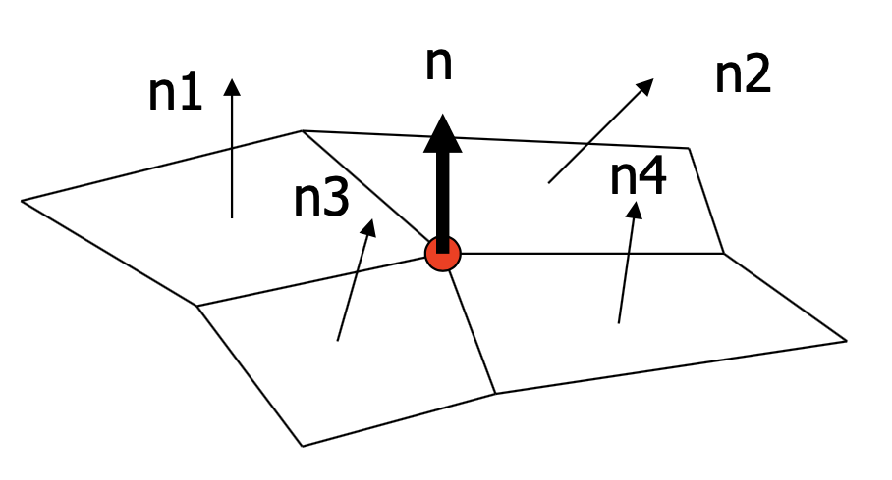
Gouraud Shading
Per-vertex lighting calculation
Normal is needed for each vertex
Per-vertex normal could be computed by averaging the adjust face normals
n = (n1+n2+n3+n4)/4.0

Slide 47
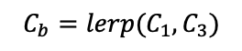
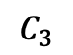
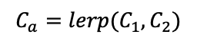



Gouraud Shading
Compute vertex illumination (color) before the projection transformation
Shade interior pixels: color interpolation (normal are not needed)
$$C_{a}=lerp(C_{1}, C_{2})$$
$$C_{b}=lerp(C_{1}, C_{3})$$
$$C_{1}$$
$$C_{2}$$
$$C_{3}$$
$$C_{c}=lerp(C_{a}, C_{b})$$
lerp: linear interpolation

Slide 48
Gouraud Shading
Problem: lighting in the polygon interior can be inaccurate

Slide 49
Phong Shading
Instead of interpolation, we calculate lighting for each pixel inside the polygon (per pixel lighting)
We need to have normal for all the pixels – not provided by the user
Phong shading algorithm interpolates the normal and compute lighting during rasterization
Need to map the normal back to world or eye space though

Slide 50






Phong Shading
$$n_{a}=lerp(n_{1}, n_{2})$$
$$n_{b}=lerp(n_{1}, n_{3})$$
$$n_{1}$$
Normal interpolation
Good image quality, but need more computation
$$n_{3}$$
$$n_{2}$$
$$n_{c}=lerp(n_{a}, n_{b})$$

Slide 51
Phong Shading Implementation Concept
Vertex shader
As usually transform vertex to clip space (gl_Position)
Transform “vertex normal vector” and “vertex position” to world space. Put them in varying variables and pass to the fragment shader
Fragment shader
Because WebGL interpolate information you put in varying variables, you will receive per-fragment ”normal vector”, “position” in world space
With “light position” and “eye position” in world space (you may pass them into shaders by uniform variables), you can calculate illumination for every fragment

Slide 52
Transformation of Normal Vector
Normal vector is one of the key components in illumination calculation
In the beginning, the normal vector is also defined in the object space
Usually, you need to transform normal vectors to the world space with the object for illumination calculation
But it may NOT be always correct if you simply apply the model matrix to normal vector directly
n=(1,0,0)
If we directly apply
model matrix to normal vector
Translate along Y by 1
n = (1,1,0)
incorrect!
Rotate 45 degrees
n = (1,1,0)
OK!
After the rotation
Scale by (sx=2, sy=2)
n = (2,2,0)
OK! If you normalize n
After the rotation
Scale by (sx=1, sy=2)
n = (1,2,0)
incorrect!

Slide 53

Transformation of Normal Vector
The right matrix to transform the normal vectors
If $M$ is your model matrix, use ${{(M}^{−1})}^{T}$ to transform the normal vectors
Proof:
$n$: the normal vector before transformation
$s$: the surface(edge) before transformation
$n′$: the correct normal vector after transformation
$s$’: the surface(edge) after transformation
$M$: the model matrix
$M′$: the correct matrix to transform normal vector (what we want)
$n^{′}∙s^{′}=0$ (they should be perpendicular with each other)
$⇒{(M}^{′}∗n)∙(M∗s)=0$
$⇒ {{(M}^{′}∗n)}^{T}∗(M∗s)=0$ ($∵a$ $∙b=a^{T}∗b$, where $a, b$are vectors)
$⇒ n^{T}∗{M^{′}}^{T}∗ M∗s=0$ ($∵$(A $∗{B)}^{T}=B^{T}∗A^{T}$)
$$n∙s=0$$
$⇒ n^{T}∗s=0$ ($∵a$ $∙b=a^{T}∗b$, where $a, b$are vectors)
${{ M}^{′}}^{T}∗M=I (∵n^{T}∗{M^{′}}^{T}∗{M∗s}^{′}=0,$ $n^{T}∗s=0$)
$${⇒M}^{′}={{(M}^{−1})}^{T}$$
n’
n
s
s’

Slide 54


Example (Ex06-4)
Correct normal vector transformation and illumination
Files
index.html
WebGL.js
cuon-matrix.js

Slide 55

Example (Ex06-4)
draw() in WebGL.js
Calculate ${{(M}^{−1})}^{T}$ for normal vector transformation

Slide 56

Example (Ex06-4)
Shaders in WebGL.js
We still use modelMatrix to transform object vertices to world space
But, we have to use “u_normalMatrix” to correctly transform normal vectors to world space
Comparing with Ex06-3, this two points are the only differences

